Slide 1
Doctor Artur Steiner: Artur.Steiner@gcu.ac.uk
Strategies for empowering disadvantaged rural communities
The XXVII European Society for Rural Sociology Congress
Krakow 24-27th July 2017

Slide 2
Recent policy changes
EU and UK policies encourage service co-production through community engagement, empowerment, asset ownership, capacity-building and enhanced community resilience
EU and SG interventions through LEADER

Slide 3
Policy directions
The ‘reform agenda will empower communities to come together to address local issues… giving new powers and rights to neighbourhood groups’ (Conservative Party, 2015).
One of the National Outcomes: ‘We have strong, resilient and supportive communities were people take responsibility for their own action and how they affect others’ (Scottish Government, 2014).
Community Empowerment Bill: ‘communities are a rich source of talent and creative potential and the process of community empowerment helps to unlock that potential. It stimulates and harnesses the energy of local people to come up with creative and successful solutions to local challenges’ (Scottish Government, 2014).

Slide 4
Meaning of Empowerment
A process of transition from a state of powerlessness to a state of relative control (Sadan, 1997).
A united and systematic effort by a group to gain control over and improve their aggregated lives by defining problems, assets, solutions, and the processes by which change can occur (Reininger et al., 2006).

Slide 5
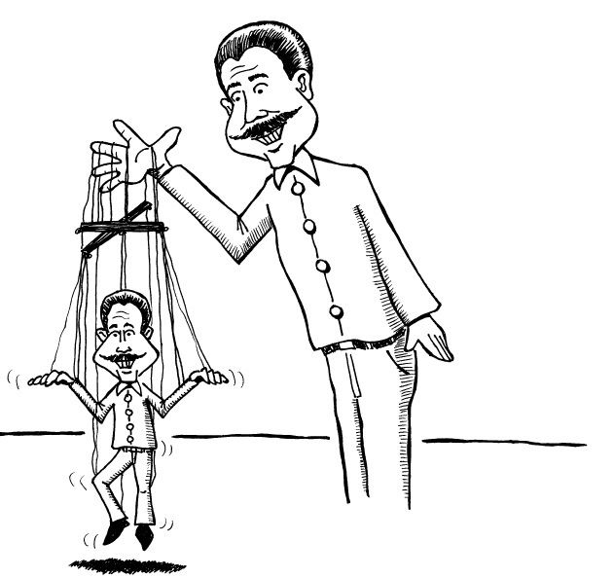
Practical concerns
How does the transition from state dependent to empowered should happen?
Notes:
5

Slide 6
Practical concerns
Are all communities equally empowered?
What do we do with communities that are less capable and do not engage?
‘It can only be expected that community-based strategies for self-help will increase the division and inequality in rural towns by empowering a small, fairly powerful minority who are better positioned to mobilise themselves’ (Herbert-Cheshire, 2000).

Slide 7
The movement from the ‘hierarchically organised intervening state’ towards the ‘cooperative state’ needs to be better understood (Margarian, 2011).

Slide 8
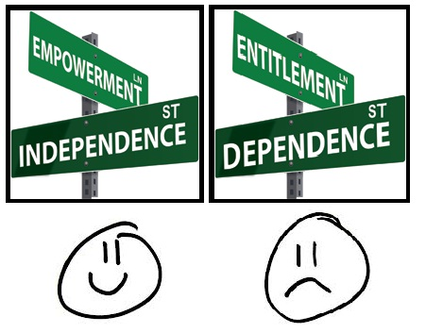
Empowerment approaches
Endogenous - having an internal cause or origin, growing or originating from within.
Exogenous - having an external cause or origin, growing or originating from outside.
Notes:
Both concepts relate to:
the extent to which a community is capable of running community programmes supporting local development.
the ability or inability of exercising power in a particular

Slide 9
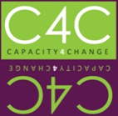
Capacity for Change Programme
C4C = Capacity for Change
What is the driving force of the C4C initiative?
To build community capacity and enable less-resourced communities to become empowered and resilient
Why should we work with less-resourced communities?
Current LEADER approach might not be efficient
Support goes to ‘capable’ communities
Less-resourced communities miss out on potential support

Slide 10
Process of C4C development
Identification of communities that meet all inclusion criteria
C4C publicity and community engagement activities
(Community meetings, face to face and one to one meetings, leaflets and notice boards information)
Verification community readiness and willingness
Supported community action (communities working with a project officer, financial support to develop local projects)
Selection of a project idea
Project implementation and service co-production

Slide 11
Research questions
Overarching research objectives:
How effective is the overall C4C intervention?
What difference does C4C make to the participating communities?
What improvements could be made to the C4C programme to make it more effective?
Community empowerment questions:
How does the community empowerment process begin?
Who should be responsible for the process of empowerment?

Slide 12
Methodology of the study
Stage 1
Initiation of
the research process
Stage 2
Exploring C4C
processes
Stage 3
Finalising the study
Development of C4C hybrid evaluation model
Baseline data collection
Quantitative & Qualitative info
In-depth interviews with C4C stakeholders
Interviews with C4C project manager
Exploring How? Why? and Who?
Final data collection
Quantitative & Qualitative info
Longitudinal data
Measuring change
Notes:
12

Slide 13
Data collection
7 villages were invited to take part in the programme and 6 of them accepted the invitation
Stage 1 involved conducting 178 face-to-face, semi-structured interviews
Stage 2 involved over 30 in-depth interviews
Stage 3 involved conducting 137 face-to-face interviews

Slide 14
C4C results
C4C communities identified diversified priorities and different local needs inducing:
Community garden
Kitchen project
Heritage project
Community sculpture
Community path linking two villages
3 out of 6 villages successfully completed the project

Slide 15
Project successfully completed

Slide 16
Engagement
Funding source as a platform for community engagement: ‘We got something for nothing didn’t we?…I think the idea’s excellent…the fact that there is finance available’.
Supported community action and work of a project manager: ‘Obviously we didn’t know what we were doing and we had somebody to guide us. You definitely need somebody that knows how the project works to help you work through it.’

Slide 17
Participation
Being part of a region programme as a trigger of community participation: ‘We often feel that we are neglected. So to be part of this project was great’.
Confidence as an essential component building community empowerment: ‘People will be interested and perhaps that will encourage, just even if it's half a dozen people, to get more involved...so that's a real advantage’.
Development of social capital through community involvement: ‘it forced people to work together who normally wouldn’t, so that was a positive. It led within the village to an opening of communication channels which was also positive’ .

Slide 18
Empowerment
Development of new and appreciation of existing resources: ‘We've actually got to the end…there is a tangible result now. And it got the village talking... it’s an extra facility’.
Citizen power: ‘now we’re looking into ways to raise money separately to try and get a carpet put in the hall to make it nicer so that if we are having people hiring the hall for a café…so from the kitchen it’s spawning other ideas to make the hall more useable’.

Slide 19
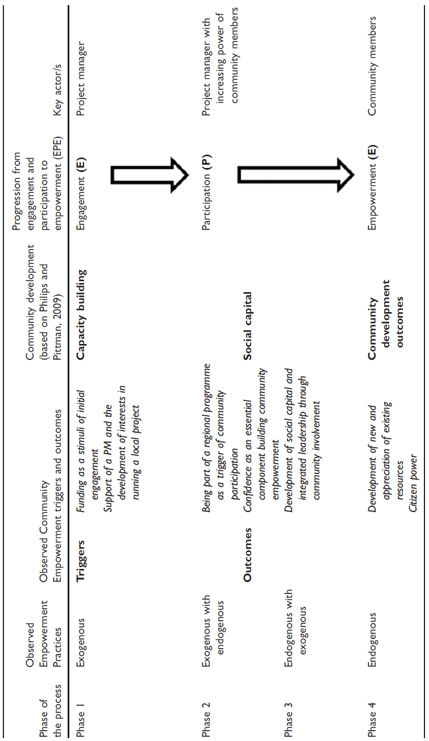

Slide 20
Observations
Empowering communities that do not engage includes:
Engagement (run by a community development officer)
Participation (which involves collaborative work and transfer of power, resources and control from the development officer to community members)
Empowerment (a stage in which communities take ownership of the project and run the community development initiative)

Slide 21
Conclusions
In relation to communities that do not engage, community empowerment needs to be facilitated and should start with building the capacity of communities.
The research highlights a need for tailored structural support.
The assumption that all communities might be ready to do things for themselves is unrealistic.
Notes:
Empowerment is understood quite instrumentally here as something that communities can be induced into, through an exogenously-engineered and guided ‘broad’ framework. Providing a safe and structured context where people were brought together allowed for the opening of new communication channels involving different individuals, groups and interests. This was significant in influencing the development of empowerment. Tangible outcomes of completed projects (including a community garden, village hall kitchen and a heritage project) became a legacy representing community effort to improve selected aspects of the local social fabric. Participants exhibited capability to participate in a decision-making process and to transform choices into desired outcomes.

Slide 22
Conclusions
Elements of endogenous and exogenous empowerment are necessary for empowerment of communities that have little apparent history of government-induced civic engagement.
Exogenous agencies could add value by providing an enabling environment where endogenous development occurs.
Notes:
Endogenous and exogenous empowerment are not mutually exclusive and separate
to reach endogenous empowerment – exogenous empowerment practices are useful and effective for some communities. Our EPE model highlights that a process of community empowerment starts with engagement, followed by participation – with these assets being a precondition of developing empowered communities. Communities that have not previously engaged can benefit from external support.
Helpful actors in this space could be a PM/community development worker who guides and supports community members in a process of empowerment. Building community empowerment and transferring power from the exogenous worker/project to endogenous community members requires time, financial
resources and appropriate skills. The PM/project must, in a sense, build a bridge between endogenous and exogenous actors and resources. Bridging involves capacity building and social capital building

Slide 23
Thank you for your attention
C4C publications:
Steiner, A. and Farmer, J. (2017) Engage, participate, empower: modelling power transfer in disadvantaged rural communities Environment and Planning C.
Steiner, A. (2016) Assessing the effectiveness of a capacity building intervention in empowering hard to reach communities. Journal of Community Practice, 24(3), 235-263.
Steiner, A. Woolvin, M. and Skerratt, S. (2016) Measuring community resilience over time: developing and applying a ‘hybrid evaluation’ approach. Community Development Journal. Steiner, A. and Markantoni, M. (2014) Exploring Community Resilience in Scotland through Capacity for Change. Community Development Journal, 49(3), 407-425.
Skerratt, S. and Steiner, A. (2013) Working with communities-of-place: complexities of empowerment. Local Economy, 28(3), 320–338.
Contact details: Artur.steiner@gcu.ac.uk

Slide 24
Key statistical results
C4C successfully completed projects
The overall level of resilience increased (change statistically significant)
C4C villages that did not successfully complete their projects
The overall level of resilience decreased (change is not statistically significant)

Slide 25
Advantages and Positive Changes
Funding source as a platform for community engagement
Being part of a regional programme as a trigger of community participation
Development of social capital through community involvement
Knock-on effect and added value
Confidence as an essential component of the community resilience process
Development of new and appreciation of existing resources

Slide 26
C4C Challenges
Lack of sufficient information about C4C
Misunderstanding of the C4C concept
Admin & Management issues
Suspicions and scepticism
Diverse community needs
Hesitance to change
Timelines & Deadlines
Personal agendas, disputes and conflicts
Financial accountability
Keep C4C going

